Slide 1
Course Content Simplification AI Agent
CAPSTONE PROJECT
Presented By: Sindhu Katakam
College Name : SR University
Department : CSE-AIML

Slide 2
OUTLINE
Problem Statement
Technology used
Wow factor
End users
Result
Conclusion
Git-hub Link
Future scope
IBM Certifications

Slide 3
Problem Statement
The Challenge – Educational materials often vary in complexity and are not always accessible to learners with different levels of prior knowledge. Students may struggle to grasp key concepts due to jargon heavy or overly advanced explanations in faculty notes and textbooks. The challenge is to develop an AI powered agent that can intelligently analyze academic content and reframe explanations based on the learner's current proficiency—ranging from beginner to expert. This would support more inclusive learning and personalized education delivery at scale.
Proposed Solution: An AI-powered educational assistant using IBM Cloud services to make academic content more accessible for learners at different proficiency levels. Using Watsonx AI Studio and Runtime, we built and deployed a model that rewrites complex content based on the user's understanding. The IBM Agent Lab powers an interactive chatbot, while the Granite Foundation Model enables advanced natural language processing to simplify or enhance explanations. The system assesses the learner’s level and delivers customized content—beginner to expert—accordingly. This solution supports inclusive, scalable, and personalized learning, helping students grasp concepts more effectively and at their own pace.

Slide 4
Technology used
IBM cloud lite services
Natural Language Processing (NLP)
Retrieval Augmented Generation (RAG)
IBM Granite model

Slide 5
IBM cloud services used
IBM Cloud Watsonx AI Studio
IBM Cloud Watsonx AI runtime
IBM Cloud Agent Lab
IBM Granite foundation model

Slide 6
Wow factors
Personalized Learning at Scale Dynamically adapts explanations to each learner's level—from beginner to expert.
Powered by Enterprise-Grade AI Built using IBM Watsonx AI Studio, Runtime, and the Granite Foundation Model for high accuracy and scalability.
Real-Time Content Simplification Instantly rewrites complex academic content into simpler, more understandable formats.
Interactive Chatbot Experience Engages users through an AI agent built with IBM Agent Lab, making learning conversational and user-friendly.
Inclusive & Accessible Education Breaks down barriers in traditional learning by tailoring content for all learners, regardless of background.
No Human Expert Needed Automatically adapts content—no need for manual rephrasing or teacher intervention.
Cloud-Native and Scalable Deployed on IBM Cloud, ensuring reliability, high performance, and easy scalability.
Supports Continuous Learning Learners can progress at their own pace with AI adapting to their growing understanding.

Slide 7
End users
Students
School, college, and university students needing tailored explanations to match their learning level.
Educators & Instructors
Teachers and faculty who want to supplement teaching with adaptive learning tools.
Self-Learners & MOOC Participants
Individuals using online platforms who benefit from simplified content.
Early-Stage Researchers
Those new to academic writing and research needing support understanding complex literature.
Learners with Diverse Backgrounds
Non-native speakers or students from varied educational systems who need more accessible material.
Educational Institutions & EdTech Companies
Schools, universities, and platforms looking to integrate personalized learning solutions.
Training & Corporate Learning Departments
Organizations providing upskilling or technical training tailored to employee skill levels.

Slide 8
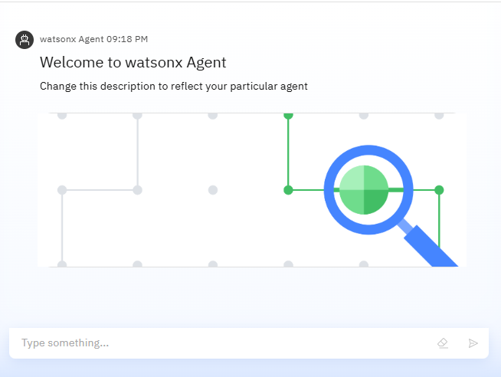
Results

Slide 9
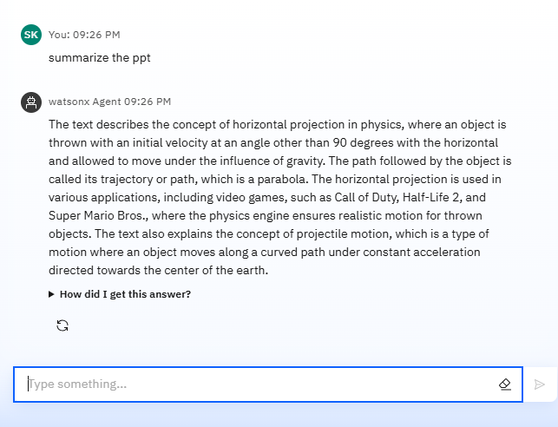
Results

Slide 10
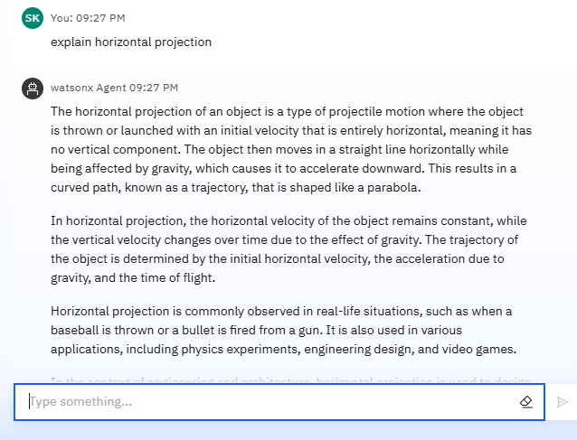
Results

Slide 11
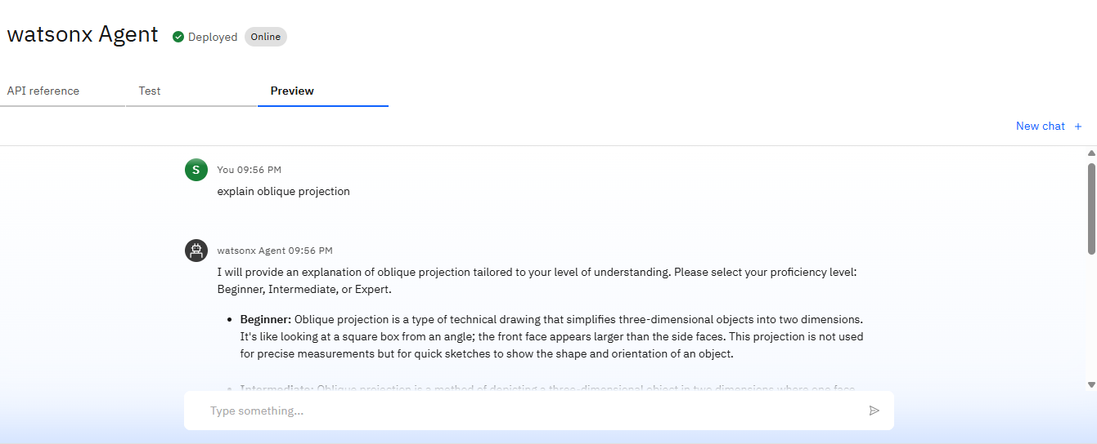
Results
Deployed AI Agent

Slide 12
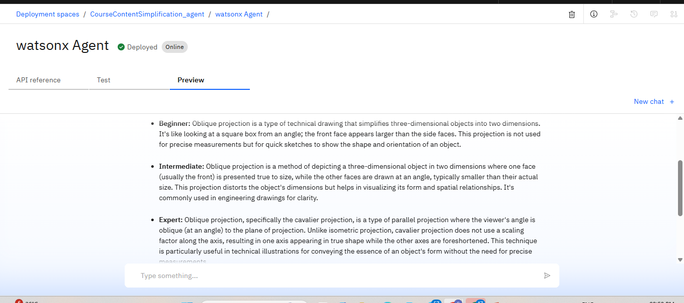
Results
Deployed AI Agent

Slide 13
Conclusion
Our AI-powered educational assistant transforms the way academic content is delivered by making learning personalized, inclusive, and scalable.
By leveraging IBM Watsonx, Granite Foundation Models, and Agent Lab, we have created a solution that adapts content based on the learner’s proficiency—empowering students to learn smarter and faster.
This innovation not only enhances understanding and engagement but also supports equity in education, enabling all types of learners to thrive.
With its real-world applicability, scalability, and cutting-edge AI integration, our project stands as a forward-thinking step toward the future of education.

Slide 14
Future scope
Multilingual Support Expand to support content adaptation across multiple languages for global accessibility.
Adaptive Learning Pathways Integrate AI to not only simplify content but also suggest personalized learning roadmaps based on performance and interests.
Integration with Learning Management Systems (LMS) Seamless integration with platforms like Moodle, Canvas, or Google Classroom for wider educational use.
Advanced Analytics Dashboard Provide teachers and institutions with real-time insights into learner progress, content difficulty, and engagement.
Voice-Based Interaction Enhance the assistant with speech-to-text and text-to-speech for hands-free, inclusive learning experiences.
Offline & Mobile Access Develop mobile and offline versions to ensure access in low-connectivity areas.
Collaboration with EdTech Companies & Institutions Partner with educational platforms and universities for large-scale deployment and testing.

Slide 15
IBM Certifications
Screenshot/ credly certificate( getting started with AI)

Slide 16
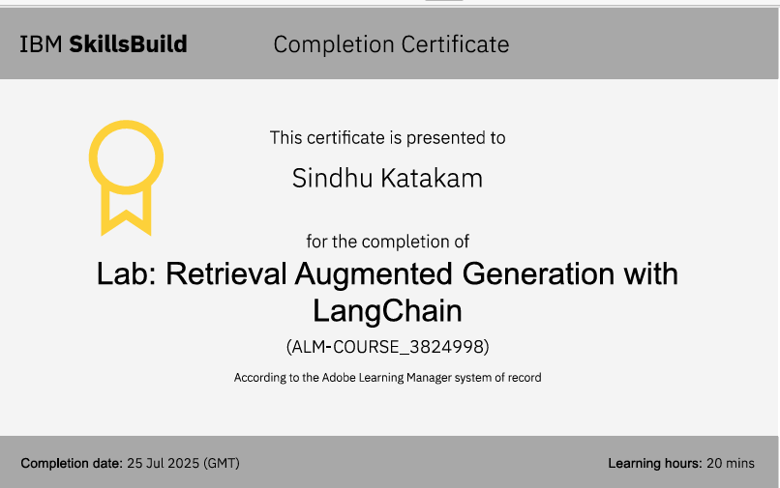
Attach your RAG LAB certificate here

Slide 17
GitHub Link
https://github.com/Sindhukatakam21/CourseContentSimplification_Agent-

Slide 18
THANK YOU

